Slide 1
Data Presentation
Marketing Analytics Project

Slide 2
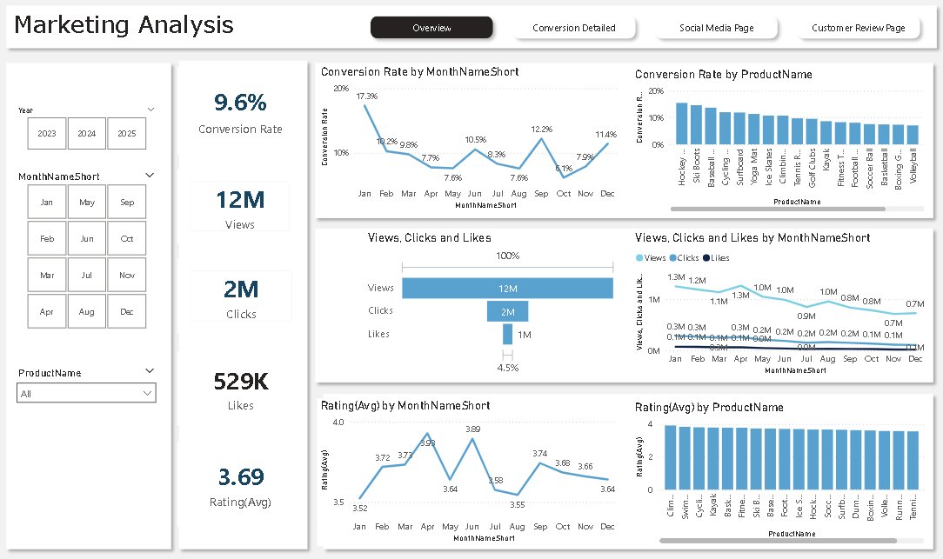
Overview
1. Conversion Rate Analysis
The conversion rate showed fluctuations throughout the year. It started strong at 17.3% in January, declined during mid-year, reached its lowest point of 6.1% in October, and recovered to 11.4% in December.
2. Customer Engagement Analysis
The company generated 12M views, 2M clicks, and 529K likes. However, views consistently declined throughout the year from 1.3M in January to 0.7M in December.
3. Customer Feedback Analysis
The average customer rating is 3.69, which remained relatively stable throughout the year but stayed below the target benchmark of 4.0.

Slide 3
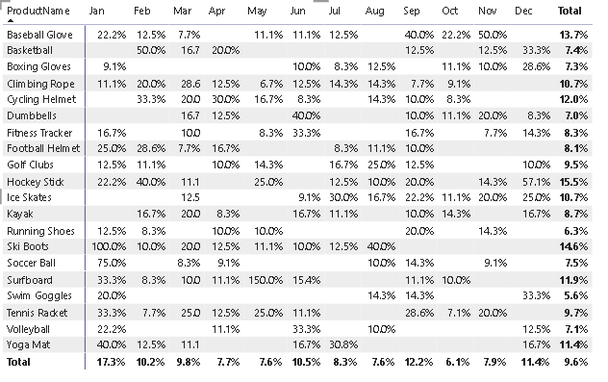
Decreased Conversion Rates
1. General Conversion Trend:
Throughout the year, conversion rates fluctuated across different products and months. The overall conversion rate remained highest in January (17.3%), followed by relatively strong performance in February (10.2%) and June (10.5%). This indicates seasonal demand patterns and highlights opportunities to improve performance during weaker months.
2. Lowest Conversion Month:
October recorded the lowest overall conversion rate at 6.1%, where most products showed relatively weaker conversion performance. This suggests a need to revisit marketing campaigns, promotional strategies, or product targeting during this period.
3.Highest Conversion Rates:
January recorded the highest overall conversion rate at 17.3%, driven by strong product performance such as Ski Boots (100%), Soccer Ball (75%), and Basketball (50%) in specific months. This indicates strong seasonal demand and effective campaign performance during peak periods.

Slide 4
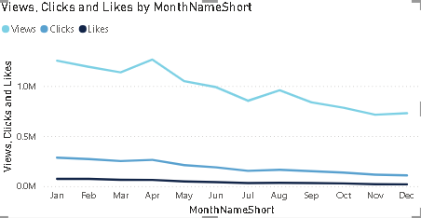
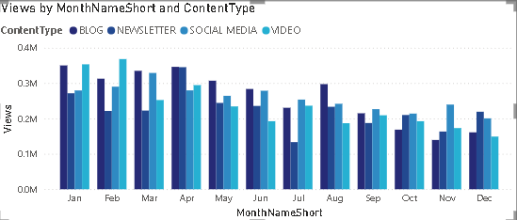
Reduced Customer Engagement
Declining Views:
Overall views were highest during the first half of the year, peaking around April (approximately 1.3M views). After April, views showed a consistent downward trend and dropped to nearly 0.7M by November and December, indicating reduced audience reach in the later months.
Low Interaction Rates:
Clicks and likes remained significantly lower compared to total views throughout the year. Although users were viewing content, lower interaction levels suggest the need for more engaging content and stronger call-to-action strategies.
Content Type Performance:
Social Media content generated the highest views in the early months, particularly in February and March. Blog and Newsletter content maintained relatively stable performance throughout the year, while Video content showed comparatively lower engagement in most months.

Slide 5
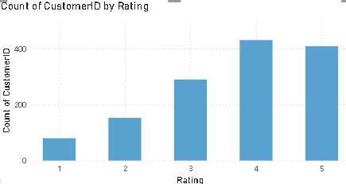
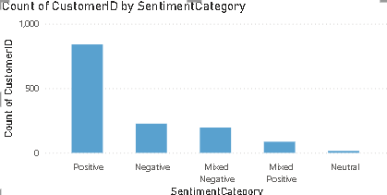
Customer Feedback Analysis
Customer Ratings Distribution:
The majority of customer reviews fall under higher ratings, with 4-star ratings having the highest count (around 430 customers), followed by 5-star ratings (around 410 customers). Lower ratings such as 1-star and 2-star reviews are significantly lower, indicating that overall customer satisfaction is generally positive.
Sentiment Analysis:
Positive sentiment dominates customer feedback, with approximately 800+ customers, showing that most customers had a favorable experience. Negative, mixed negative, and neutral sentiments are comparatively lower but still highlight areas where customer experience can be improved.
Opportunity for Improvement:
Although overall feedback is positive, the presence of negative, mixed negative, and neutral sentiments indicates opportunities to improve product quality, customer service, and post-purchase experience. Addressing these concerns can help increase customer satisfaction and generate more positive reviews.

Slide 6
Goals & Actions
GOALS
1.Increase Conversion Rates:
Goal: Identify factors affecting product conversion rates and improve performance during low-converting months.
Insight: Conversion rates were highest in January (17.3%) and improved again in December (11.4%), while October recorded the lowest conversion rate (6.1%). Products like Ski Boots, Soccer Ball, and Baseball Gloves showed strong conversion performance during specific months.
2. Enhance Customer Engagement:
Goal: Identify content performance trends and improve audience engagement.
Insight: Overall views declined throughout the year, dropping from nearly 1.3M views in early months to around 0.7M in later months. Clicks and likes remained significantly lower than views. Social media content performed better in early months, while engagement declined in the later months.
3.Improve Customer Feedback Scores:
Goal: Understand customer sentiment patterns and improve customer satisfaction.
Insight: Most customers gave 4-star and 5-star ratings, showing overall positive satisfaction. Positive sentiment dominated customer reviews, but negative and mixed feedback highlighted areas where product and service improvements are needed.
Actions
Increase Conversion Rates:
Focus marketing efforts on high-performing products such as Ski Boots, Soccer Ball, and Baseball Gloves. Run seasonal campaigns during high-performing months and improve promotional strategies during low-performing months like October.
2. Enhance Customer Engagement:
Improve content strategy by creating more engaging content formats such as videos, interactive posts, and personalized campaigns. Strengthen call-to-actions to improve clicks and likes, especially during low-engagement periods.
3. Improve Customer Feedback Scores: Analyze negative and mixed reviews to identify recurring customer issues. Improve product quality and customer service experience to increase average ratings and convert neutral customers into satisfied customers.

